Slide 1

Feeding the Eight Billion
Dr Marcus Travers
Agri-Food Technology ARU-Peterborough

Slide 2
How technology has changed and will change food production
How can we feed the planet while protecting ecosystems and reducing carbon emissions

Slide 3
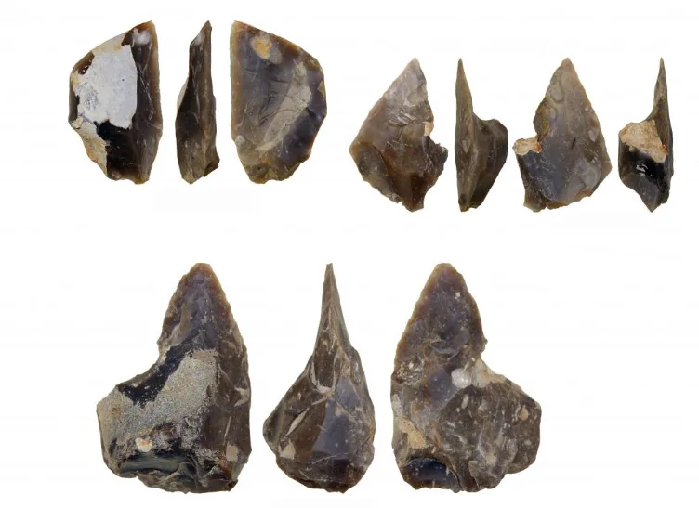

In the Beginning

Slide 4

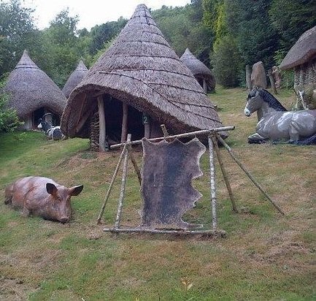
Land Management

Slide 5

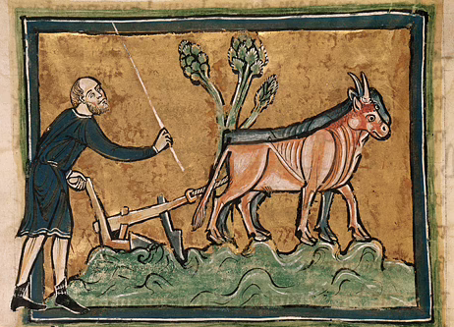
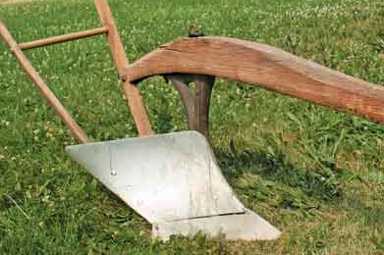
The Plough

Slide 6
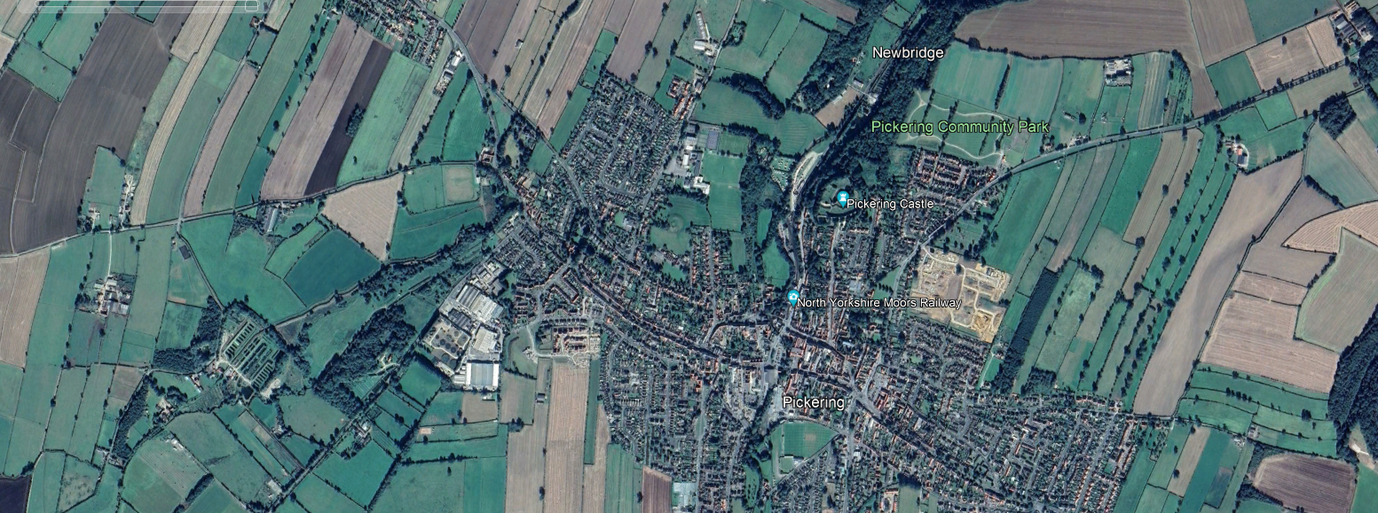
Continuing Changes

Slide 7
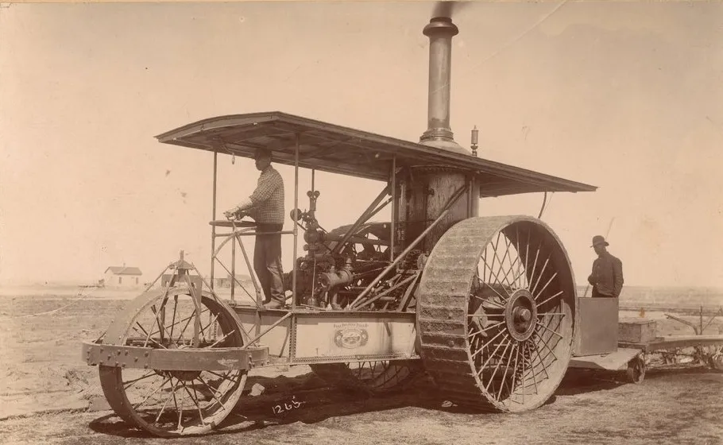
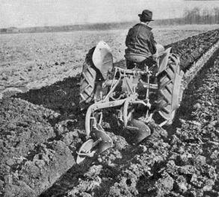
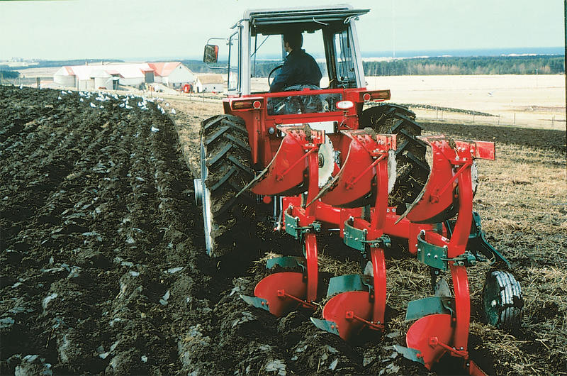
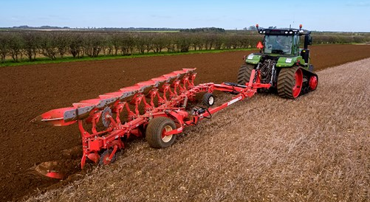

The Plough

Slide 8
The Plough

Slide 9
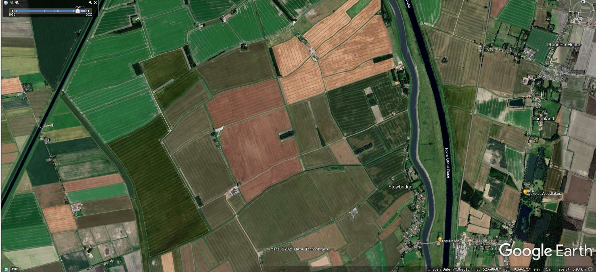
Continuing Changes

Slide 10
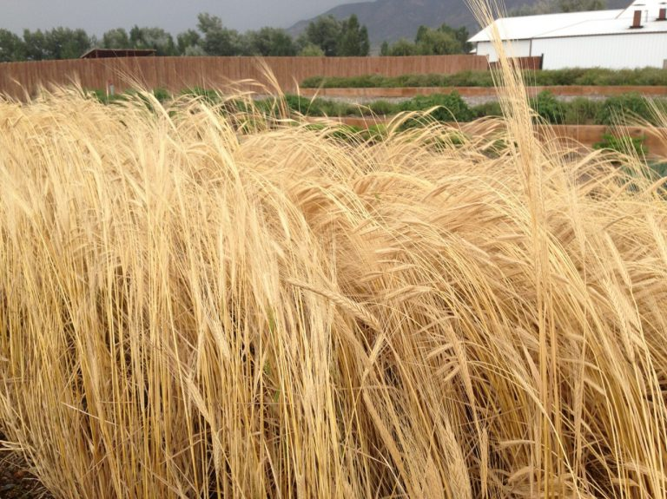



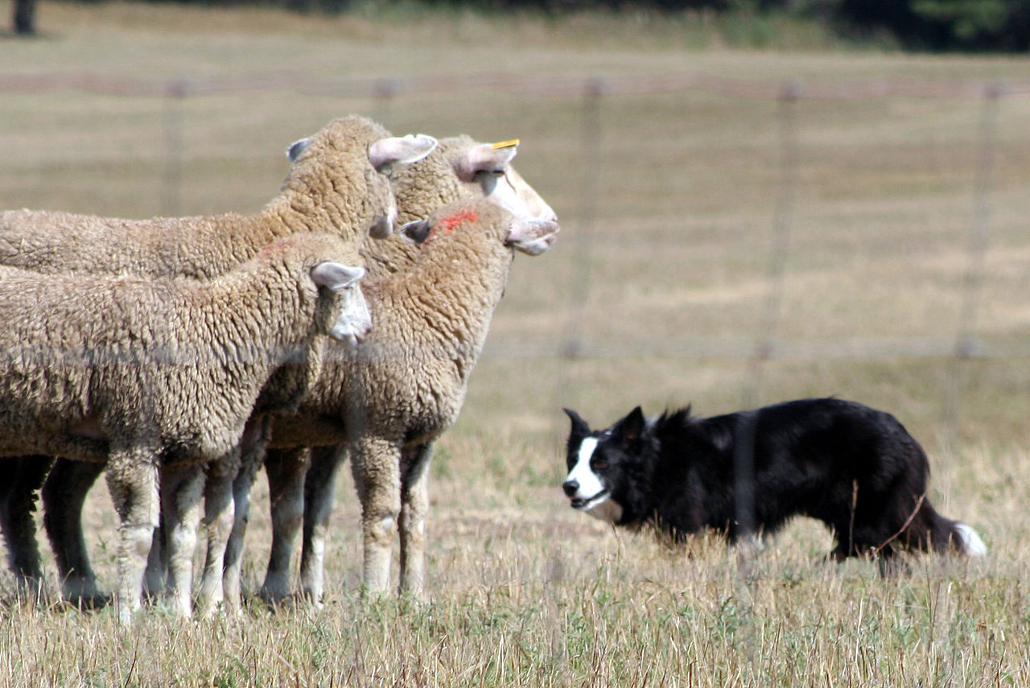
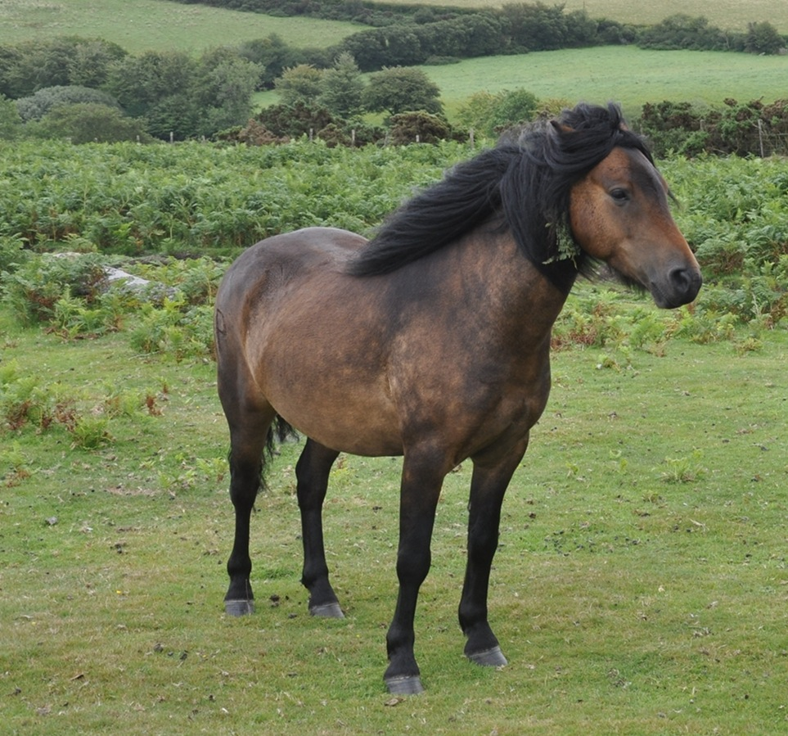
In the Beginning

Slide 11
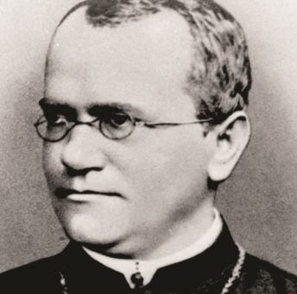
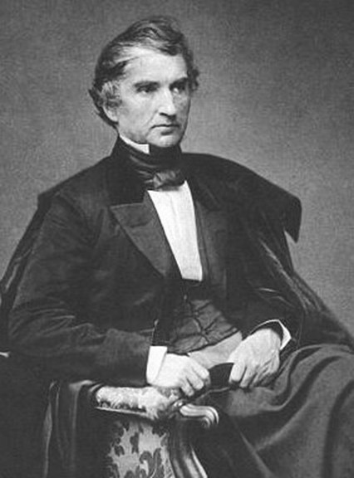
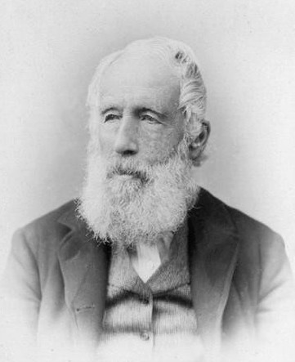
The Power of Plants

Slide 12
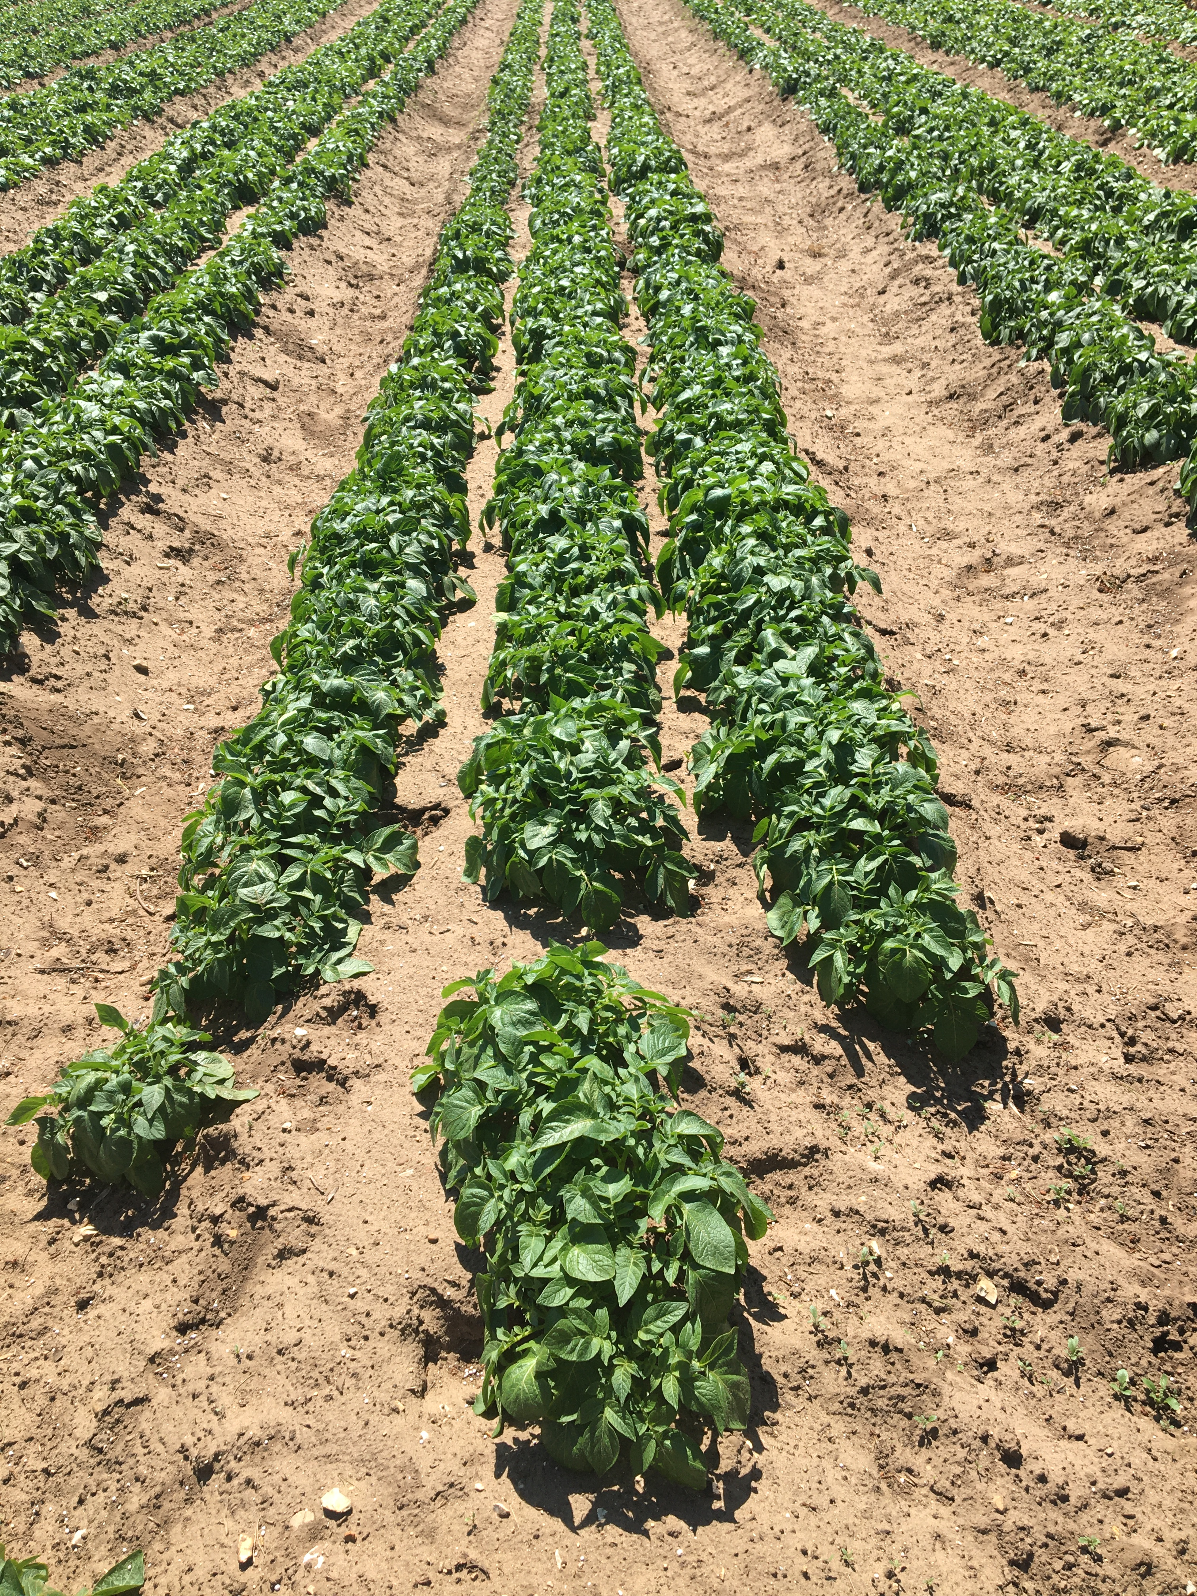
Can We Produce Enough Food?
In 2011, FAO presented the estimate that around 1/3 of the world’s food was lost or wasted every year.

Slide 13
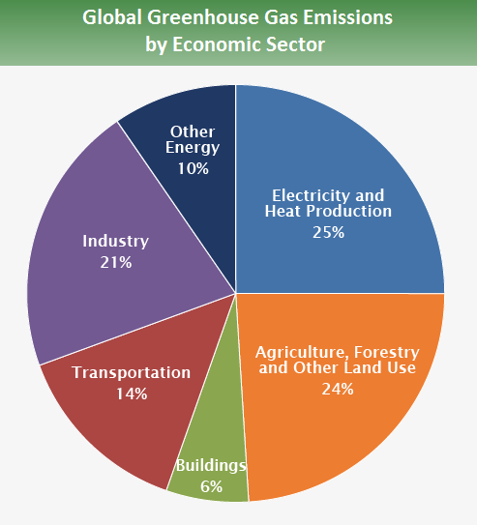
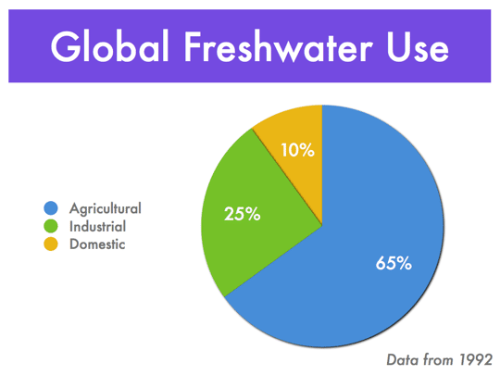
However
from The ImpEE Project, The Cambridge-MIT institute.
from Contribution of Working Group III to the Fifth Assessment Report of the Intergovernmental Panel on Climate Change

Slide 14
What Brings About The GHG Emissions?
Inputs
Ploughing
Other farm activities
Animals

Slide 15
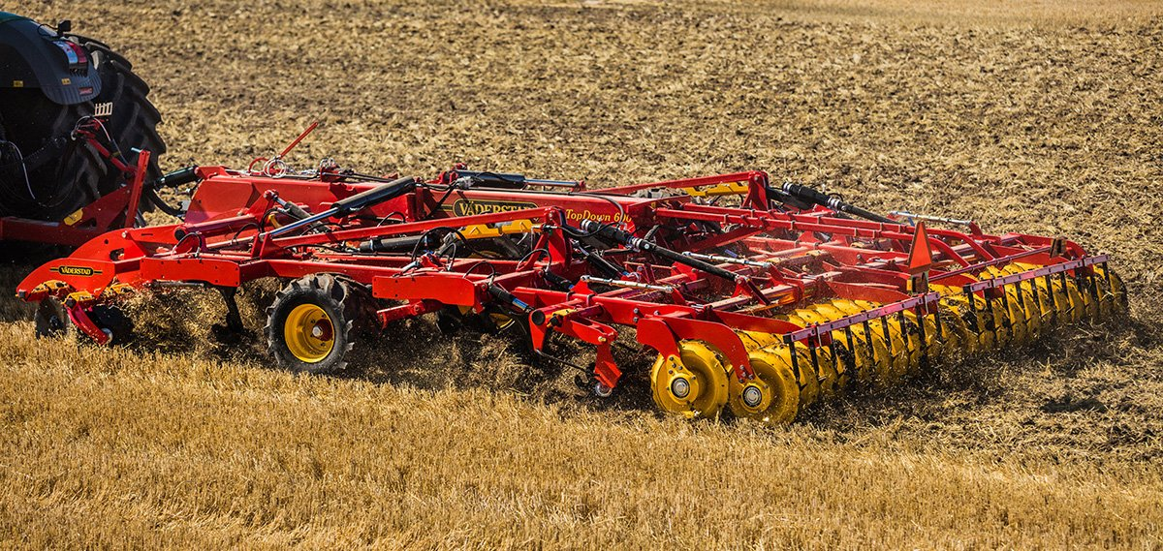
Min-Till, No-Till, Restorative and Vertical

Slide 16
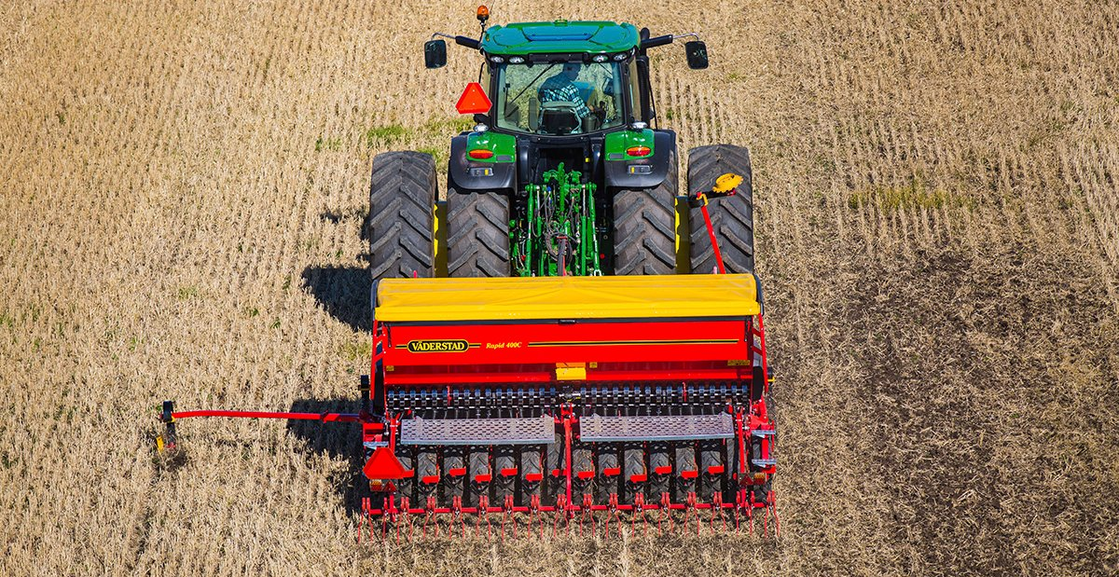
Min-Till, No-Till, Regenerative and Vertical

Slide 17
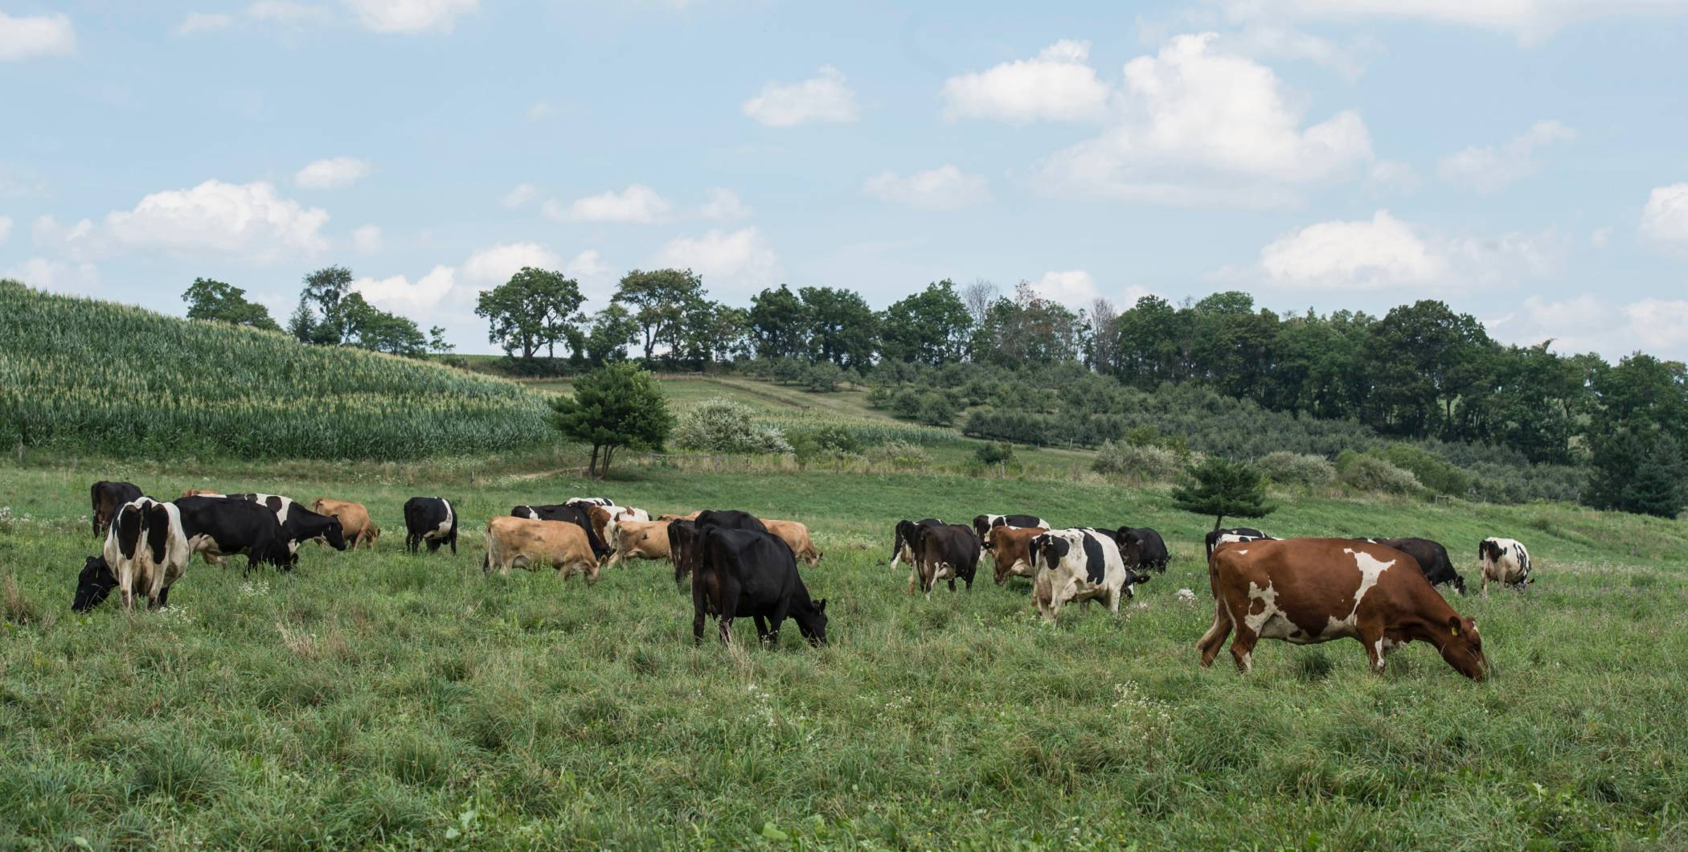
Min-Till, No-Till, Regenerative and Vertical

Slide 18
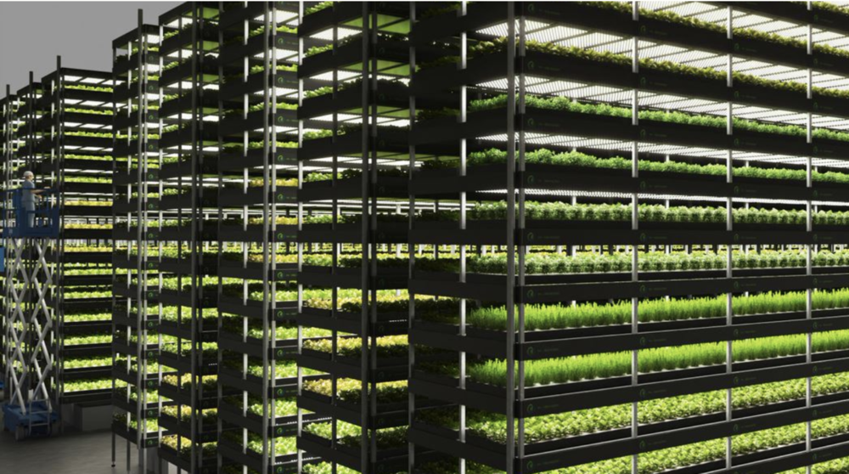
Min-Till, No-Till, Regenerative and Vertical

Slide 19
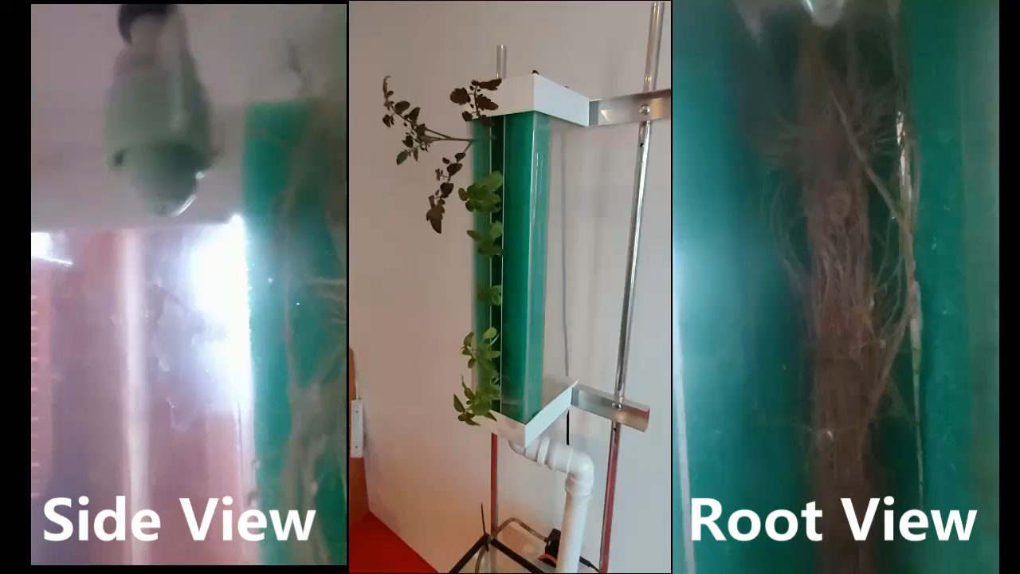
Min-Till, No-Till, Regenerative and Vertical

Slide 20
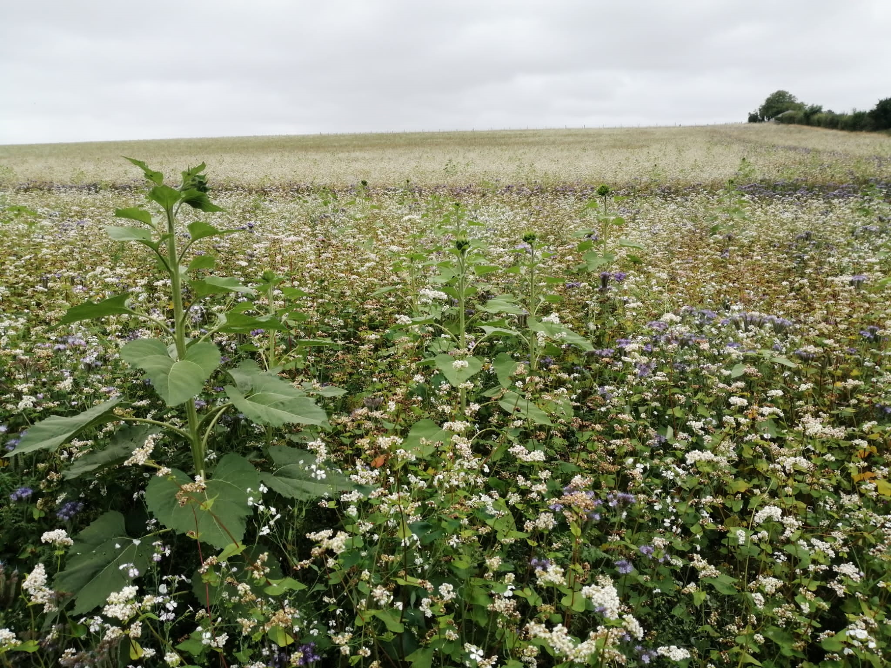
Take Land Out Of Production

Slide 21

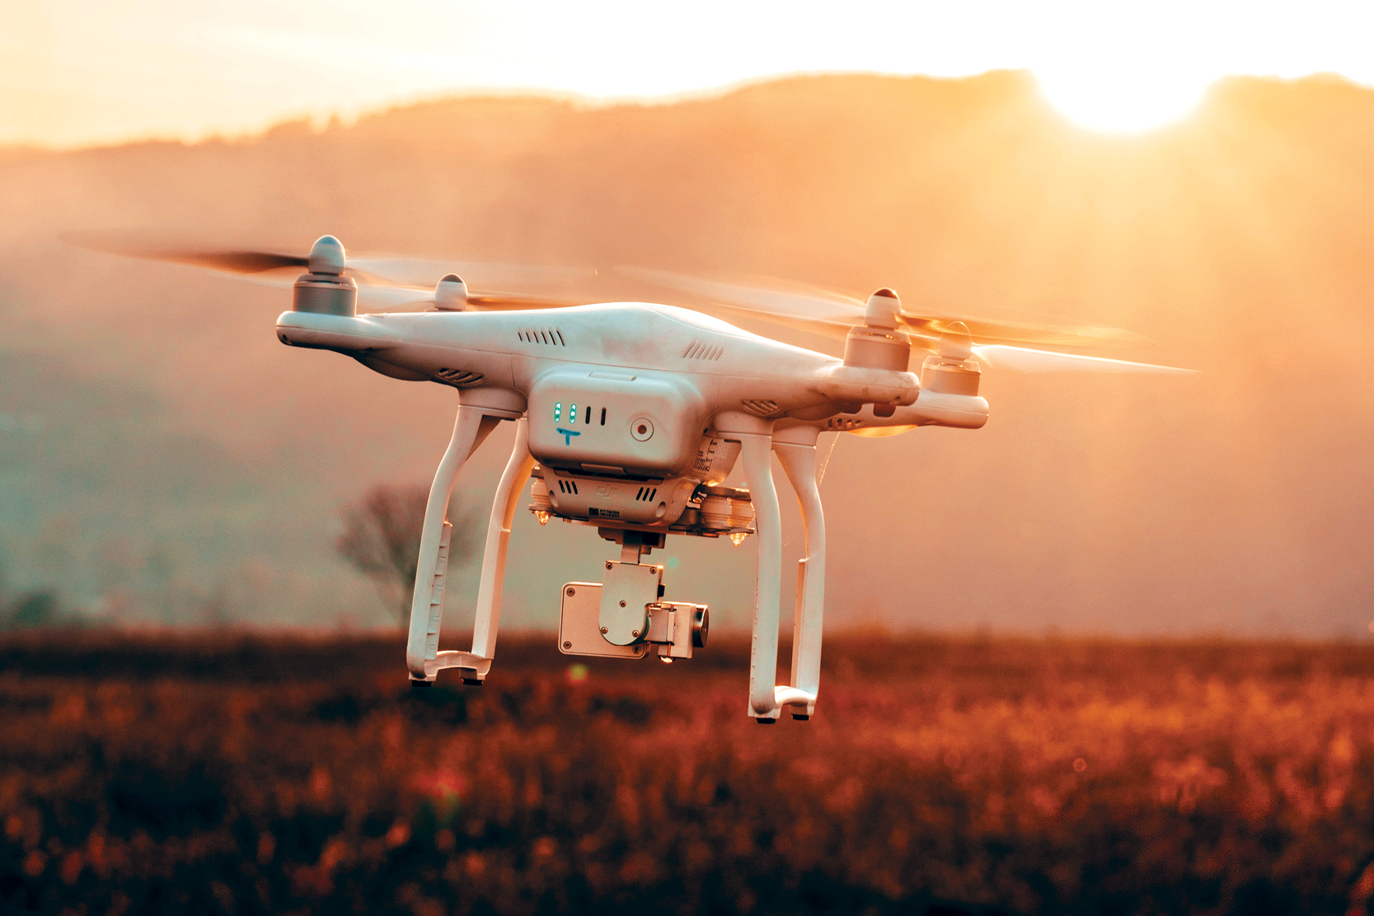
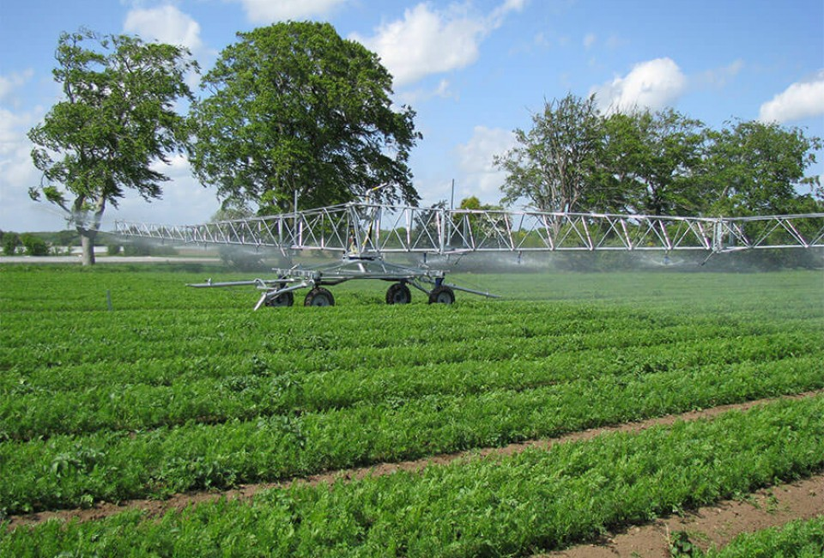

Agri-Food Technology

Slide 22
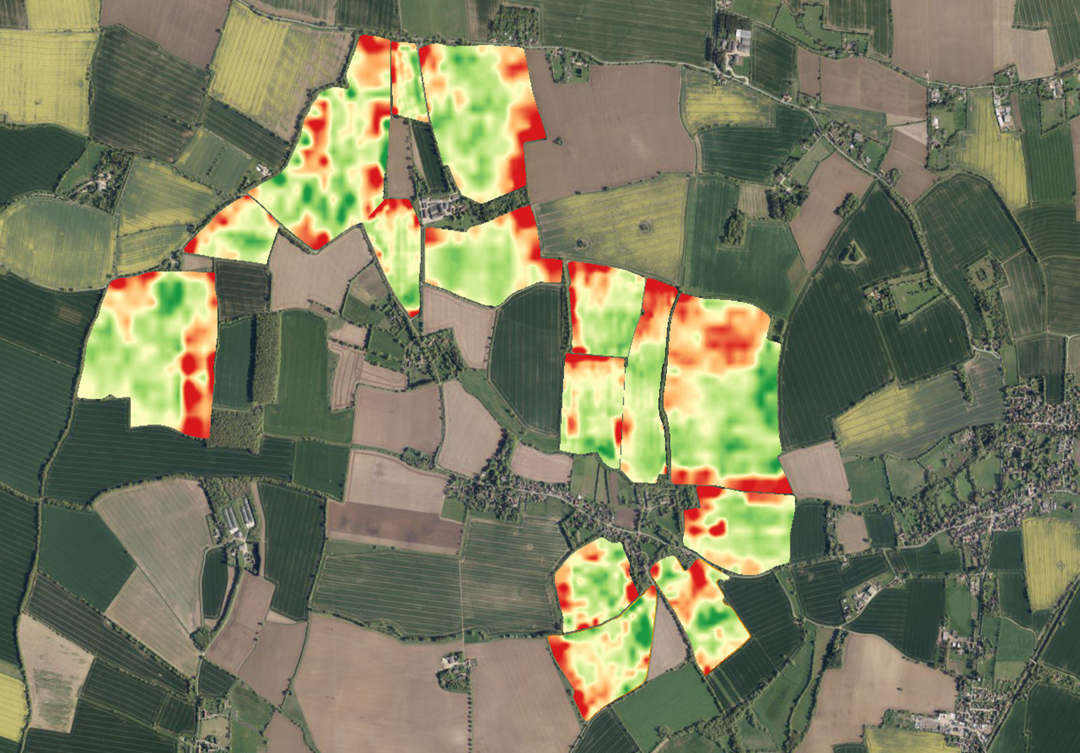
Productivity Maps

Slide 23

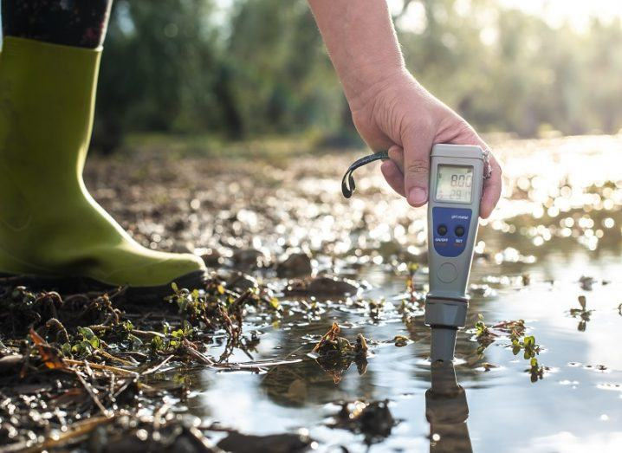
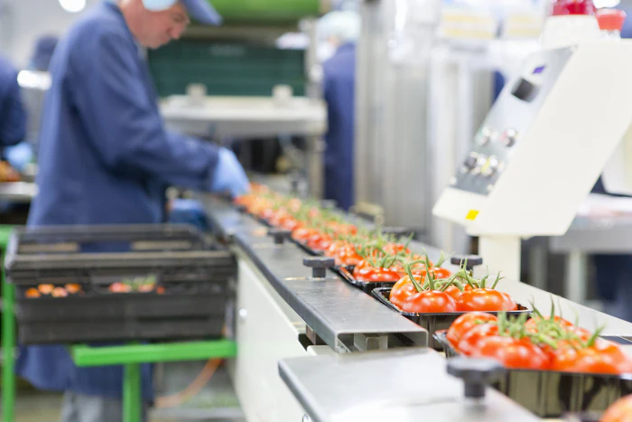
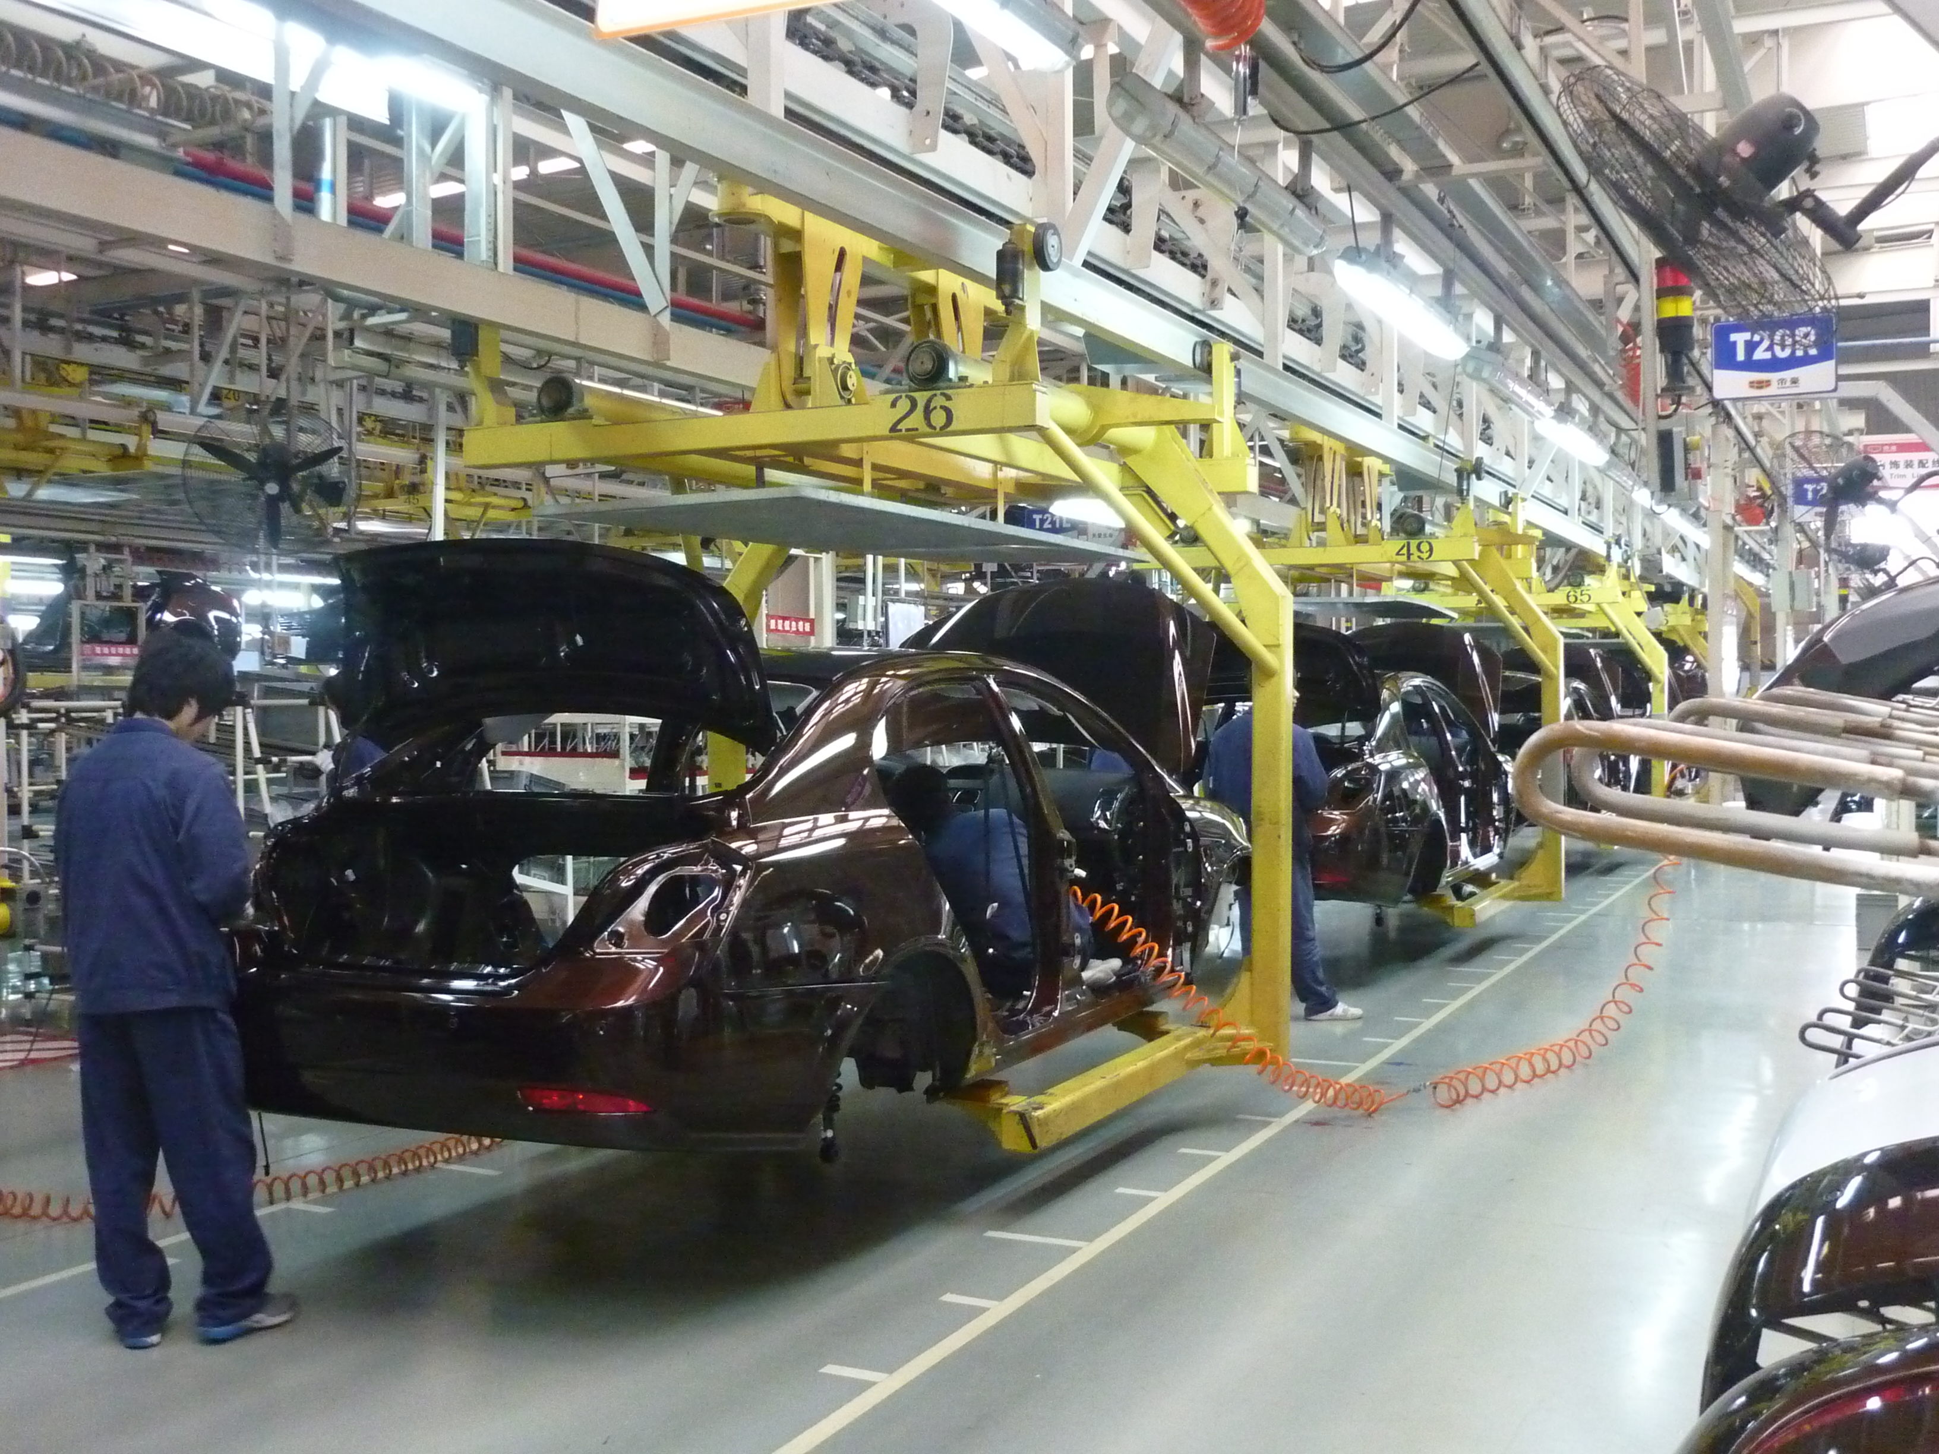
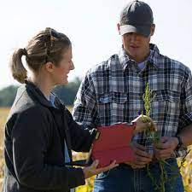
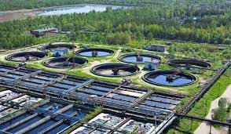
Environmental Management

Slide 24
Environmental Management
FdSc
Tri 1
Tri 2
Tri 1
Tri 2
Tri 1
Tri 2
Remote Sensing & Database Interrogation
Data Management & Geographical Information Systems
Environmental Policy & Legislation
Stakeholder Engagement
Environmental Sciences & Sustainability
Environmental Monitoring & Data Analysis
Ruskin Module
Individual Project
Environmental Challenge Project
Environmental Impact Project
Environmental Management Project
Year 1
Year 2
Year 3

Slide 25















Environmental Management
Post university opportunities and career paths.
Environmental Management, Environmental Compliance, Business Sustainability, Processing, Manufacture and Retail.
Law Conversion and Management Consultancy
MSc and PhD opportunities in Data Science, Environmental Science, Business Sustainability, and GIS.

Slide 26
UCAS Tariff & Entry Requirements
UCAS Tariff: 96 points
96 Points including at least two subjects at GCE/VCE A Level or VCE double award equivalent plus GCSE in at least four subjects grade C/4 or above including English. A grade B/5 in Maths GCSE is required.
BTEC National Certificate/Diploma attracting at least 96 UCAS points.
Students who have successfully passed the Foundation Year Zero course at level 3 offered by ARU Peterborough and have taken the relevant optional module(s) in Engineering.
Application from mature students and those with qualifications other than GCE/VCE A Level are considered on their individual merits.
Students without English as their first language will be required to be proficient to IELTS or TOEFL with a score of 6 minimum.
Advanced entry will be considered for students who have completed: HNC/D in Engineering with average merit grade or higher.

Slide 27
To find out more visit aru.ac.uk/Peterborough

